Slide 1
COVID -19 & House Prices
Amel Christy
Salvador Galliano
Wolphy Joseph

Slide 2
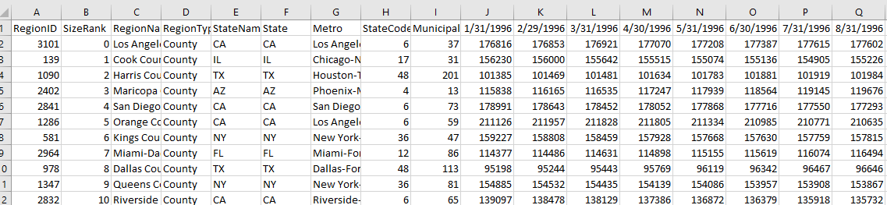
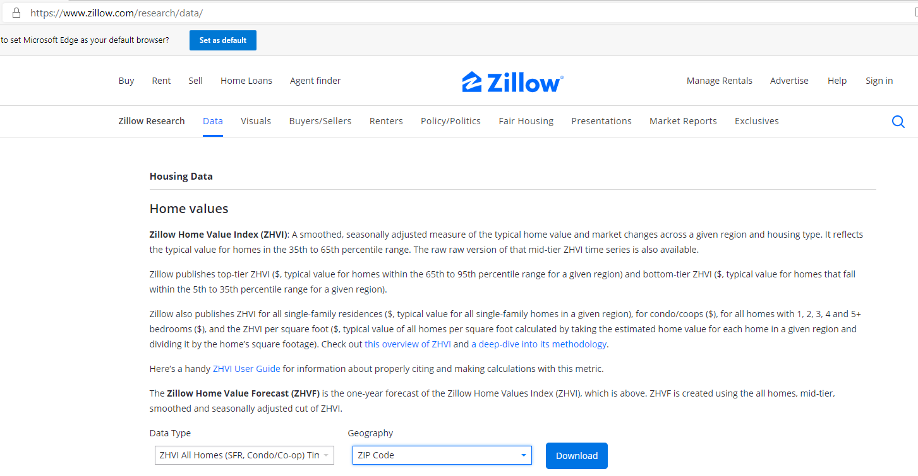
Zillow Home Value
https://www.zillow.com/research/data/
CSV File
Data was organized by county using zip code.
Historical data was displayed in columns.

Slide 3
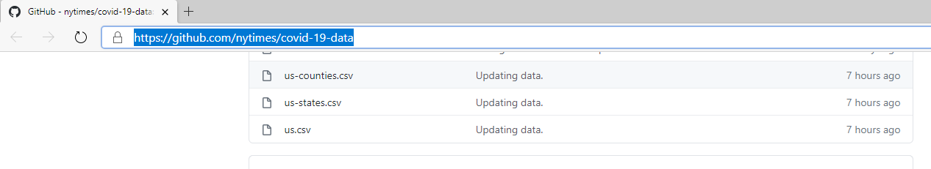
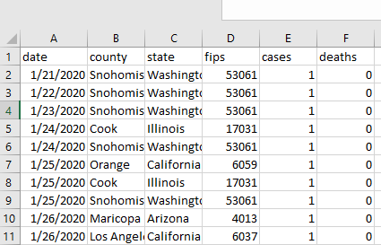
COVID-19 Cases
GitHub - nytimes/covid-19-data: An ongoing repository of data on coronavirus cases and deaths in the U.S.
Data type: CSV file
Data organized by county utilizing fips
Historical data is displayed in rows

Slide 4
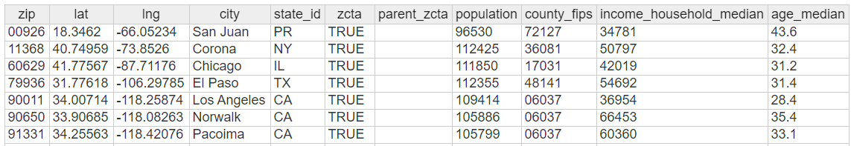
County Fips to Zip Code
https://simplemaps.com/data/us-zips
Data type: CSV file
This is file is to be used to join Covid 19 case date with house prices.

Slide 5
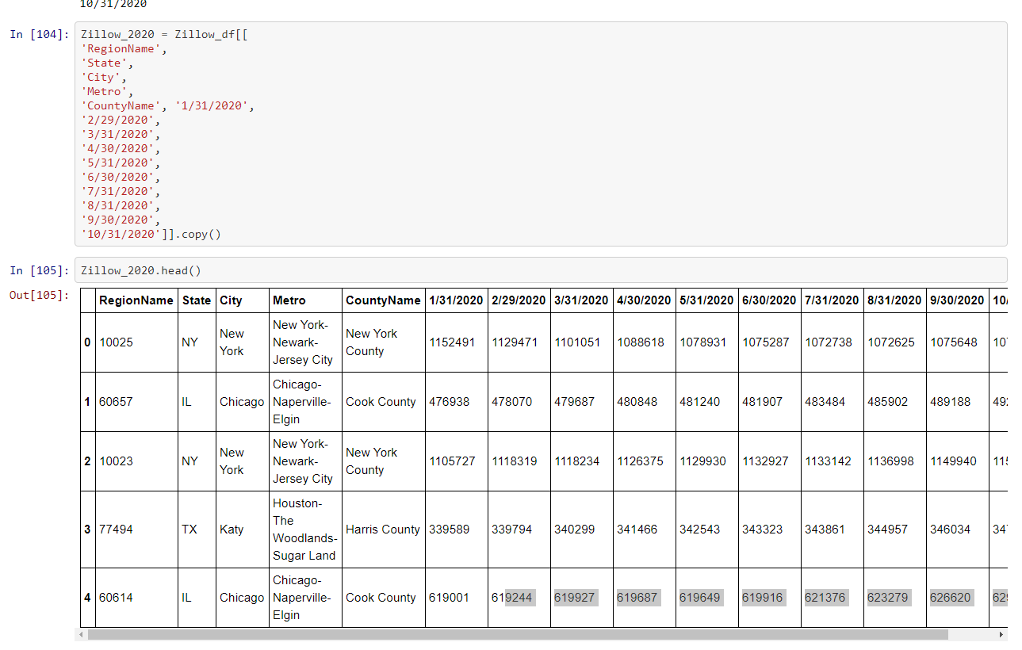
Data Clean-Up Zillow
Zillow CSV file had data going back to 1996.
Two tables were created filtering house prices to 2019 & 2020.

Slide 6
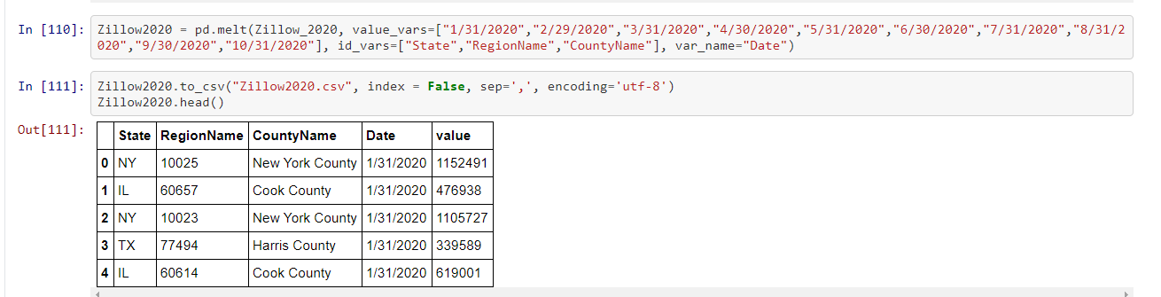
Data Clean-Up Zillow
In order to match data structure from the COVID-19 cases file historical date columns were transposed to rows
In order to complete this task. We utilized the value_vars function on Jupyter Notebooks.

Slide 7
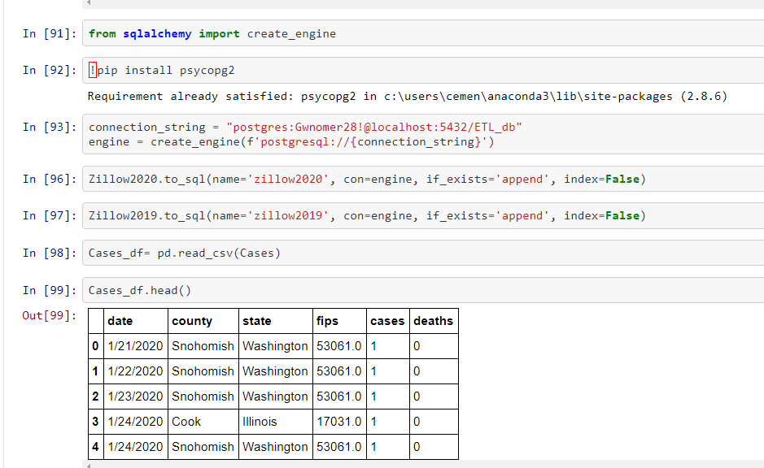
Data Export
Data was exported to SQL DB
To do list
Create make tables to translate fips to zip codes in covid data.
Build query that joins housing prices for year 2019 & 2020 with covid cases for the available months based on zip code.

Slide 8
Thank you for your time!

